Slide 1
Machine Learning & Deep Learning
Week-12
Instructor: Engr. Najam Aziz

Slide 2
Artificial Neural Network

Slide 3
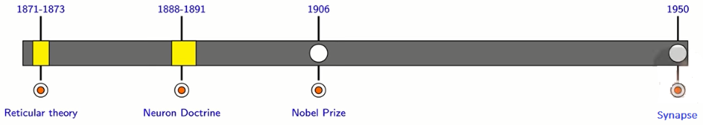
A Little History
Reticular Theory: Nervous system is a single continuous network as opposed to a network of many discrete cells - Joseph von Gerlach
Staining Technique: Camillo golgi discovered a chemical reaction that allowed him to examine nervous tissue in much greater detail than ever before - he was proponent of reticular theory
Neuron Doctrine: Santiago Ramon Cajal used golgi’s techniques to study the nervous system and proposed that it is actually made up of discrete individual cells forming a network ( opposed to single continuous network)
The Term Neuron: coined by Heinrich wilhelm gottfried around 1891 - further consolidated the Neuron doctrine - also coined the word chromosome
Nobel prize: Both Golgi (Reticular theory)and Cayal (Neuron Doctrine) were jointly awarded the 1906 nobel prize for medicine.
In 1950s electron microscopy finally confirmed the neuron doctrine by unambiguously demonstrating that nerve cells were individual cells interconnected through synapses (a network of many individual neurons)

Slide 4
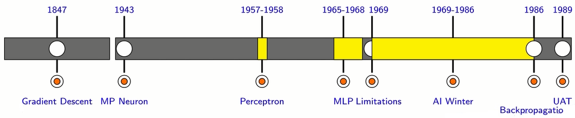
AI Spring to Winter
1943 - McCulloch (Neuroscientist) and Pitts(Logician) proposed a highly simplified model of the biological neuron - First mathematical model
Around 1956, in a conference, the term Artificial Intelligence was formally coined.
Frank Rosenblatt proposed perceptron model and said that “ perceptron may eventually be able to learn, make decisions and translate languages”.
1943 - 1968 Spring time for AI
1969 -Minsky and Papert outlined some limitations of perceptron, “single perceptron may not solve some simple problem, like XOR, but MLP can do it”
1969-1986 __AI winter
1989 -universal approximation theory- a MLP can approximate any continuous function.

Slide 5
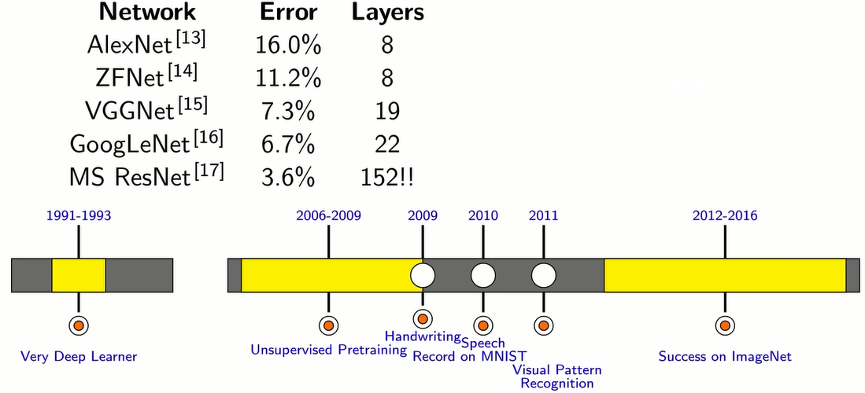
Final Boom

Slide 6
From Square One - The Biological Neuron

Slide 7
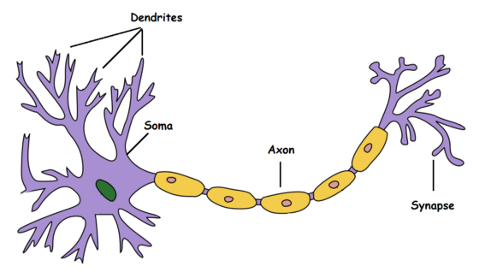
Biological Neurons: An Overly Simplified Illustration verly Simplified Illustration
Dendrite: Receives signals from other neurons
Soma: Processes the information
Axon: Transmits the output of this neuron
Synapse: Point of connection to other neurons
Basically, a neuron takes an input signal (dendrite), processes it like the CPU (soma), passes the output through a cable like structure to other connected neurons (axon to synapse to other neuron’s dendrite).
this might be biologically inaccurate as there is a lot more going on out there but on a higher level, this is what is going on with a neuron in our brain — takes an input, processes it, throws out an output.

Slide 8
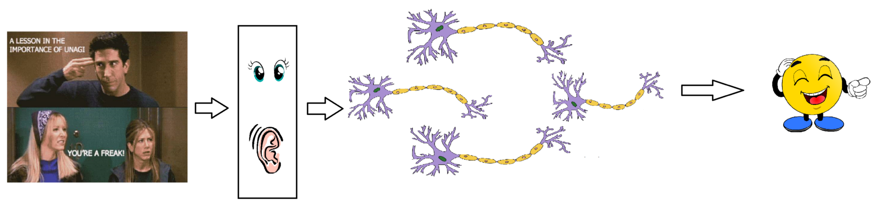
Sensory organ interacting with the outer world
Our sense organs interact with the outer world and send the visual and sound information to the neurons.
Of course, this is not entirely true.

Slide 9
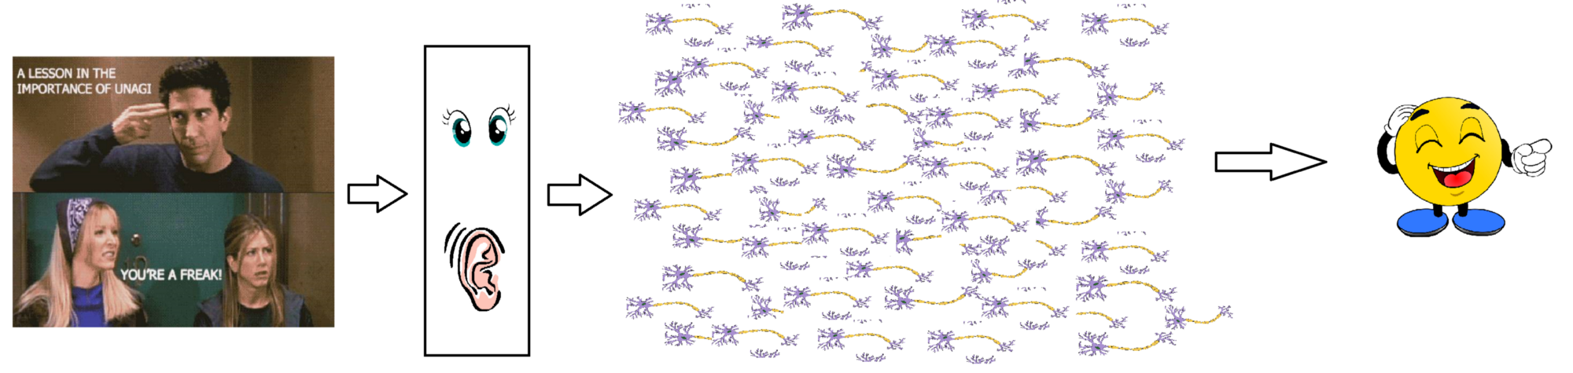
In reality, it is not just a couple of neurons which would do the decision making. There is a massively parallel interconnected network of 10¹¹ neurons (100 billion) in our brain and their connections are not as simple as shown above. It might look something like this:
Still not real, but close

Slide 10
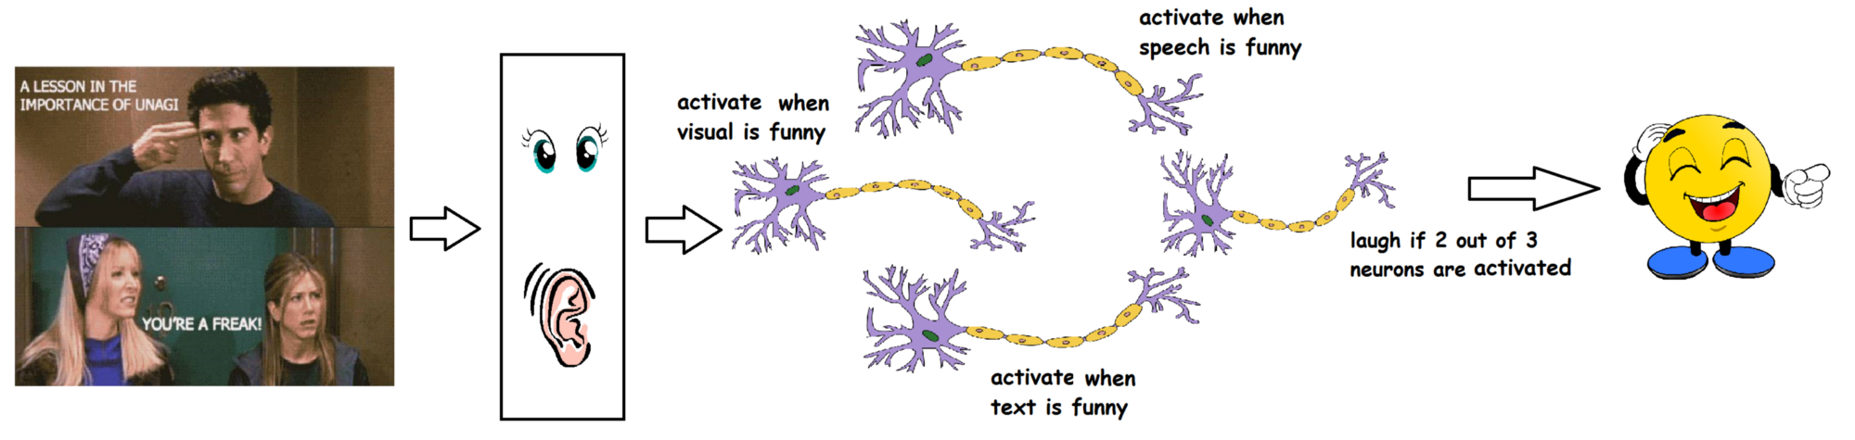
some of the neurons will fire and some won’t
This massively parallel network also ensures that there is a division of work. Each neuron only fires when its intended criteria is met i.e., a neuron may perform a certain role to a certain stimulus, as shown below.

Slide 11
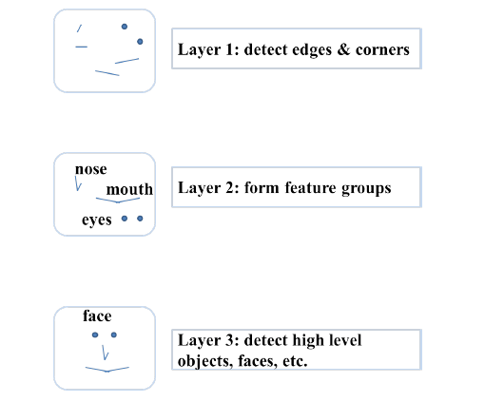
It is believed that neurons are arranged in a hierarchical fashion (layer after layer) and each layer has its own role and responsibility. To detect a face, the brain could be relying on the entire network and not on a single layer.

Slide 12
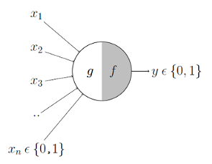
McCulloch-Pitts Neuron (Artificial Neuron) - the first ever mathematical model of a biological neuron
The first computational model of a neuron was proposed by Warren MuCulloch (neuroscientist) and Walter Pitts (logician) in 1943.
It may be divided into 2 parts.
The first part, g takes an input (dendrite), performs an aggregation and based on the aggregated value,
the second part, f makes a decision.

Slide 13
Example
Let suppose that I want to predict my own decision, whether to watch a random football game or not on TV.
The inputs are all boolean i.e., {0,1} and my output variable is also boolean {0: Will watch it, 1: Won’t watch it}.
So, x_1 could be is Premier League On (I like Premier League more)
x_2 could be is It A Friendly Game (I tend to care less about the friendlies)
x_3 could be is Not Home (Can’t watch it when I’m running errands. Can I?)
x_4 could be is Man United Playing (I am a big Man United fan.) and so on.
These inputs can either be excitatory or inhibitory.
Inhibitory inputs are those that have maximum effect on the decision making irrespective of other inputs i.e., if x_3 is 1 (not home) then my output will always be 0 i.e., the neuron will never fire, so x_3 is an inhibitory input.
Excitatory inputs are NOT the ones that will make the neuron fire on their own but they might fire it when combined together.

Slide 14
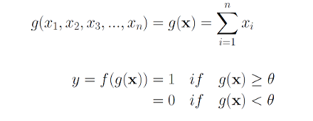
Formally, this is what is going on:
g(x) is just doing a sum of the inputs — a simple aggregation.
And theta here is called thresholding parameter.
For example, if I always watch the game when the sum turns out to be 2 or more, the theta is 2 here. This is called the Thresholding Logic.

Slide 15
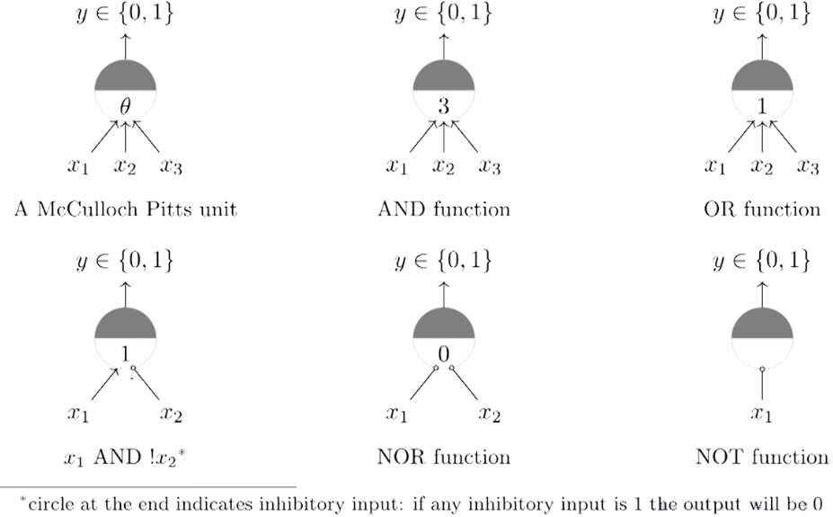
Boolean Functions Using M-P Neuron

Slide 16
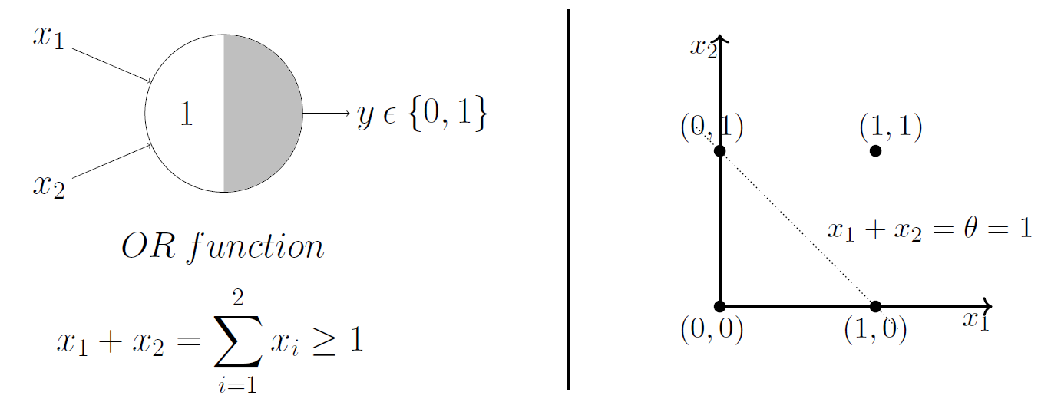
Geometric Interpretation Of M-P Neuron - The OR function
M-P neuron just learnt a linear decision boundary!
Splitting the input sets into two classes — positive and negative.
Just by hand coding a thresholding parameter, M-P neuron is able to conveniently represent the boolean functions which are linearly separable.

Slide 17
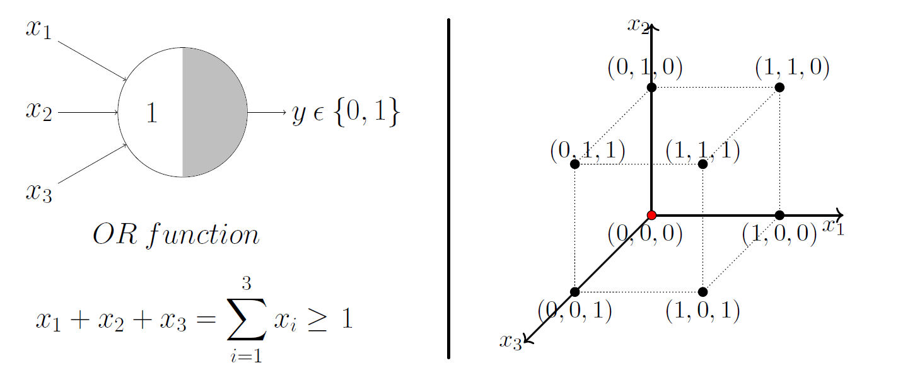
OR function with 3 input
2 Inputs - 2D - Line
3 Inputs - 3D - Plane
n inputs - nD - Hyperplane

Slide 18
Limitations Of M-P Neuron
What about non-boolean (say, real) inputs?
Do we always need to hand code the threshold?
Are all inputs equal? What if we want to assign more importance to some inputs?
What about functions which are not linearly separable? Say XOR function.

Slide 19
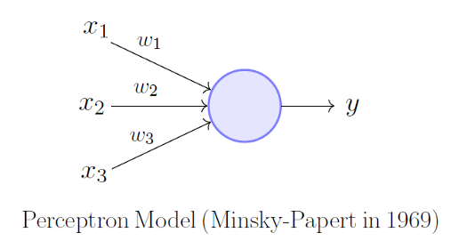
Perceptron
Overcoming the limitations of the M-P neuron, Frank Rosenblatt, an American psychologist, proposed the classical perception model, the mighty artificial neuron, in 1958. (Further refined and carefully analyzed by Minsky and Papert (1969)-The perceptron model)
More generalized computational model than the McCulloch-Pitts neuron
Introduced the concept of numerical weights (a measure of importance) for inputs, and a mechanism for learning those weights.(here weights and thresholds can be learnt over time)
Inputs are no longer limited to boolean values like in the case of an M-P neuron, it supports real inputs as well which makes it more useful and generalized.

Slide 20
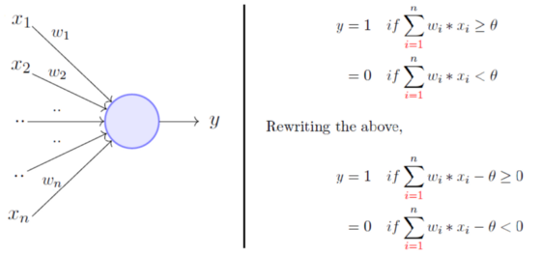
Very similar to an M-P neuron but we take a weighted sum of the inputs and set the output as 1 only, when the sum is more than an arbitrary threshold (theta).
instead of hand coding the thresholding parameter theta, we add it as one of the inputs, with the weight “-theta” like shown below, which makes it learn-able.

Slide 21
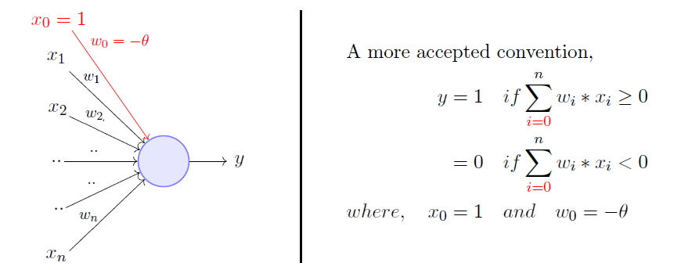
A more accepted convention

Slide 22
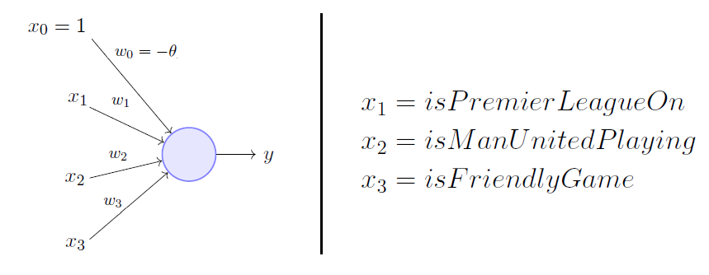
Example - watch a random game of football on TV or not
Assume decision is solely dependent on 3 binary inputs (binary for simplicity).
Here, w_0 is called the bias because it represents the prior (prejudice).
A football freak - low threshold [theta = 0]
Selective viewer - premier league game, featuring Man United game and is not friendly [theta = 2]
The point is, the weights and the bias will depend on the data (viewing history in this case). Based on the data, if needed the model may have to give a lot of importance (high weight) to the isManUnitedPlaying input and penalize the weights of other inputs.

Slide 23
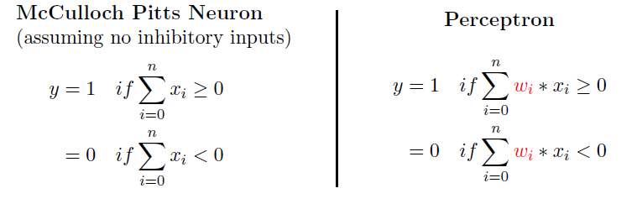
MP Neuron vs Perceptron - what’s the difference
From the equations, it is clear that a perceptron separates the input space into two halves, positive and negative. In other words, a single perceptron can only be used to implement linearly separable functions, just like the M-P neuron.
Then what’s the difference??
Here, the weights, including the threshold can be learned and the inputs can be real values.

Slide 24
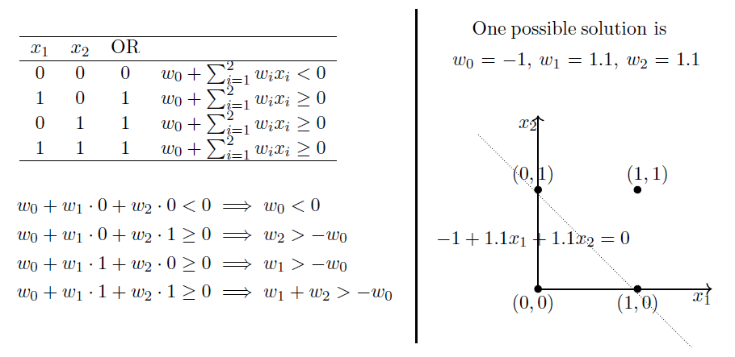
Boolean functions using Perceptron – The OR function
But which solution is the best? The one having minimum error!

Slide 25
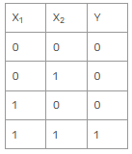
Example - Weight updates in Perceptron
Let’s say that w1 = 0.9 and w2 = 0.9 (Randomly set), Threshold = 0.5
1st instance to the perceptron. x1 = 0 and x2 = 0. Sum unit will be 0 as calculated below
Σ = x1 * w1 + x2 * w2 = 0 * 0.9 + 0 * 0.9 = 0
Sum unit = 0 for the 1st instance. So, activation unit would return 0. because it is less than 0.5. Hence output = 0. We will not update weights because there is no error in this case.
2nd instance x1 = 0 and x2 = 1.
Sum unit: Σ = x1 * w1 + x2 * w2 = 0 * 0.9 + 1 * 0.9 = 0.9>0.5 so output = 1, but target output = 0. Hence instance is not predicted correctly. That’s why, we will update weights based on the error. Error = ε = actual – prediction = 0 – 1 = -1

Slide 26
We add error times learning rate value to the weights. Learning rate = 0.5.(mostly set learning rate value between 0 and 1.)
w1 = w1 + α * ε = 0.9 + 0.5 * (-1) = 0.9 – 0.5 = 0.4
w2 = w2 + α * ε = 0.9 + 0.5 * (-1) = 0.9 – 0.5 = 0.4
3rd instance. x1 = 1 and x2 = 0
Sum unit: Σ = x1 * w1 + x2 * w2 = 1 * 0.4 + 0 * 0.4 = 0.4<0.5 hence = 0 Actual output = Target output, So We will not update weights.
4th instance. x1 = 1 and x2 = 1.
Sum unit: Σ = x1 * w1 + x2 * w2 = 1 * 0.4 + 1 * 0.4 = 0.8>0.5 = 1 Actual output = Target output, So We will not update weights.
Round 1: Prediction: 0101

Slide 27
Round2:
1st instance. x1 = 0 and x2 = 0 Sum unit: Σ = x1 * w1 + x2 * w2 = 0 * 0.4 + 0 * 0.4 = 0.4 <0.5 = 0, Correct Classification. We will not update weights.
2nd instance. x1 = 0 and x2 = 1 Sum unit: Σ = x1 * w1 + x2 * w2 = 0 * 0.4 + 1 * 0.4 = 0.4<0.5 = 0, Correct Classification. We will not update weights.
3rd & 4th instance already calculated for the current weights. And were classified correctly.
Updating weights means learning in the perceptron.
We found the best weights (w1 = 0.4, w2 =0.4) in two rounds. So, We can terminate the learning procedure here. Else the process should continue till learning completes.
In example, We set weights to 0.9 initially but it causes some errors. Then, we update the weight values to 0.4. In this way, we can predict all instances correctly.

Slide 28
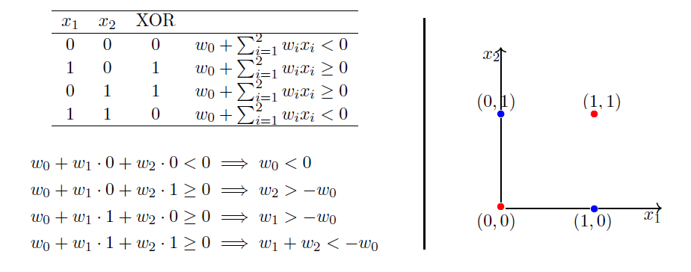
XOR Function - A non-linear boolean function
A non-linear boolean function - You cannot draw a line to separate positive inputs from the negative ones.
Notice that the fourth equation contradicts the second and the third equation.
Point is, there are no perceptron solutions for non-linearly separated data.
Key Take Away: A single perceptron cannot learn to separate the data that are non-linear in nature.(Minsky & Pappert 1969 - led to AI Winter)

Slide 29
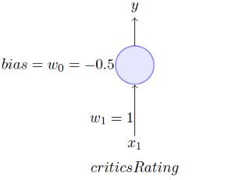
Motivation for Sigmoid Neurons - Problem with Thresholding
The artificial neurons we use today are slightly different from the perceptron we looked at before, the difference is the activation function. NEED:
The thresholding logic used by a perceptron is very harsh.
For example, if you look at a problem of deciding if I will be watching a movie or not, based only on one real-valued input (x_1 = criticsRating) and if the threshold we set is 0.5 (w_0 = -0.5) and w_1= 1 then our setup would look like this:
What would be the decision for a movie with criticsRating = 0.51? Yes!
What would be the decision for a movie with criticsRating = 0.49? No!
Isn’t its harsh that we would watch a movie with a rating of 0.51 but not the one with a rating of 0.49??
Yes it is - and This is where Sigmoid comes into the picture.

Slide 30
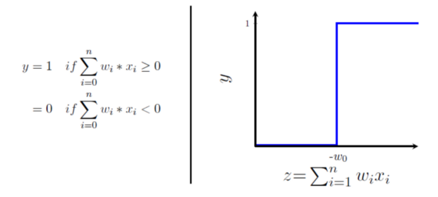
The harsh thresholding is not attributed to specific problem, but the characteristic of the perceptron function itself behaves like a step function. So it could be with any problem. There will be this sudden change in the decision (from 0 to 1) when z value crosses the threshold (-w_0).
But for most real-world applications we would expect a smoother decision function which gradually changes from 0 to 1.

Slide 31
Threshold and Activation function
American election: 50% seats Or Scottish independence referendum
Step function: seats>50 = 1 Winner---e.g. 51% seats<50 = 0, loser ----e.g 49%
..Very edgy. 51 and 49 are not very different. What about the vote/opinion of 49% people!
Sigmoid function (activation): smooth the curve seats>= 60, winner seat<= 40, loser More Significant difference of opinion. Could be implemented.

Slide 32
Perceptron & The XOR Problem (Non-Linear Data
A single perceptron cannot learn to separate the data that are non-linear in nature.(Minsky & Pappert 1969 - led to AI Winter)
...Later research shows, that Multi-layered Perceptron Network can separate non-linear data.
So...What is a Multilayer Perceptron?
But before that…What is an Artificial Neural Network?

Slide 33
Artificial Neural Network
An artificial “computing system made up of a number of simple, highly interconnected processing elements (Perceptron/Neuron), which process information by their dynamic state response to external inputs.“ inspired by the way biological neural networks in the human brain process information.
Multiple interconnected perceptrons/neurons makes an artificial neural network.
Neuron/Perceptron: information processing element/unit

Slide 34
Types of Artificial Neural Network
Based on the information flow, there are basically two types of ANN
Feedforward Neural Network (FFNN)
Multilayer Perceptron (MLP)
Convolutional Neural Network (CNN)
Feedback Neural Network (FBNN)
Recurrent Neural Network (RNN)

Slide 35
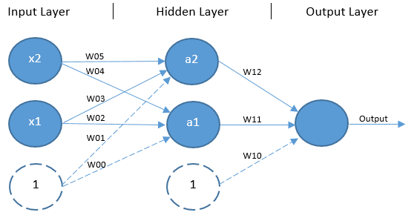
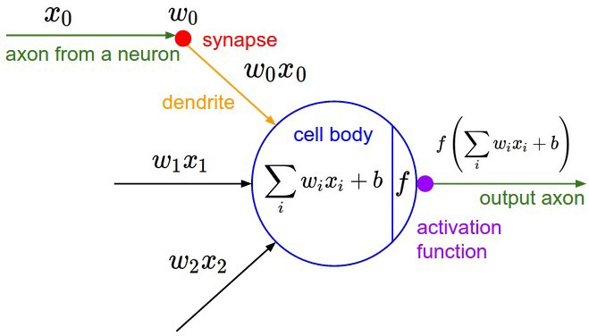
Multilayer Perceptron
The solution to XOR problem is to expand beyond the single-layer architecture by adding an additional layer of units without any direct access to the outside world, known as a hidden layer. This architecture/setup is called Multilayer Perceptron
Multiple layers of computational units, usually interconnected in a feed-forward way.
MLP can have any number of units in its input, hidden and output layers. There can also be any number of hidden layers.
Single Node/Perceptron in MLP network

Slide 36
Each hidden unit invokes an activation function — usually the classic sigmoid function in the case of the XOR problem — to squash the sum of their input values down to a value that falls between 0 and 1 (usually a value very close to either 0 or 1).
The outputs of each hidden layer unit, including the bias unit, are then multiplied by another set of respective weights and parsed to an output unit. The output unit also parses the sum of its input values through an activation function — again, the sigmoid function is appropriate here — to return an output value falling between 0 and 1. This is the predicted output.

Slide 37
Learning - Updating weights in MLP
How one might come up with a set of weight values that ensure the network produces the expected output. In practice, trying to find an acceptable set of weights for an MLP network manually would be an incredibly laborious task.
However, it is fortunately possible to learn a good set of weight values automatically through a process known as backpropagation. This was first demonstrated to work well for the XOR problem by Rumelhart et al. (1985).

Slide 38
References
McCulloch-Pitts Neuron — Mankind’s First Mathematical Model Of A Biological Neuron https://towardsdatascience.com/mcculloch-pitts-model-5fdf65ac5dd1
Perceptron: The Artificial Neuron (An Essential Upgrade To The McCulloch-Pitts Neuron) https://towardsdatascience.com/perceptron-the-artificial-neuron-4d8c70d5cc8d
Learning Parameters, Part 0: Basic Stuff: A quick look at some basic stuff essential to understand how parameters are learned. https://towardsdatascience.com/learning-parameters-part-0-5cfffd647bdc
Understanding Neural Networks: What, How and Why?. Unraveling the black box https://towardsdatascience.com/understanding-neural-networks-what-how-and-why-18ec703ebd31
How Perceptron Learn (updating weights) https://sefiks.com/2020/01/04/a-step-by-step-perceptron-example/

Slide 39
???

